Slide 1

Sentimental Analysis of Amazon Products Database
TEAM MEMBERS
Akshay Phapale 001316563
Kaushik Patil 001056490
Sachin 001054734

Slide 2
OVERVIEW
Sentiment analysis is the automated process of understanding the sentiment or opinion of a given text. This machine learning tool can provide insights by automatically analyzing product reviews and separating them into tags: Positive, Neutral or Negative. Amazon is the world’s largest e-commerce platform that sales products from various categories starting from books, electronics to home appliances. Therefore we are training our model on the amazon product dataset. The different product-specific dataset has been selected to create a model that algorithmically predict if a review is positive or negative just based on its text. The model will utilize Natural Language Processing (NLP) to predict the sentiment of a given review for a product. In this project, we will show you how to implement various Supervised Learning algorithms that can classify Amazon product reviews as positive or negative. The model will take a whole review as an input (word after word) and provide percentage ratings for checking whether the review conveys a positive or negative sentiment.

Slide 3
Objectives
Analyzing and performing feature engineering on the Amazon product review dataset.
Analyze sentiment on the dataset from the feature level.
Classification of sentiments into positive or negative using NLP and various classification algorithms.
Finding the correlation between the Amazon product reviews and the rating of the products given by the customers.

Slide 4
The flow of code
Importing Data
Data Pre-Processing
Create Training set and Validation Set
Training of the model
Prediction and Accuracy by different algorithms.
Analysis

Slide 5
ALGORITHMS USED
Multinomial Naïve Bayes
Random Forest
Decision Tree
Logistic Regression
Support Vector Machines (SVM)
k-Nearest Neighbors (KNN)

Slide 6
Dataset
Link: https://nijianmo.github.io/amazon/index.html
This Dataset is an updated version of the Amazon review dataset released in 2014. Current data includes reviews in the range May 1996 - Oct 2018. We will be using “Amazon Fashion”, “Appliances” and “Prime Pantry” dataset for our project.

Slide 7
Columns in dataset
reviewerID - ID of the reviewer
asin - ID of the product
reviewerName - Name of the reviewer
helpful - Helpfulness rating of the review
reviewText - Text of the review
overall - rating of the product
summary - summary of the review
unixReviewTime - time of the review
reviewTime - time of the review

Slide 8
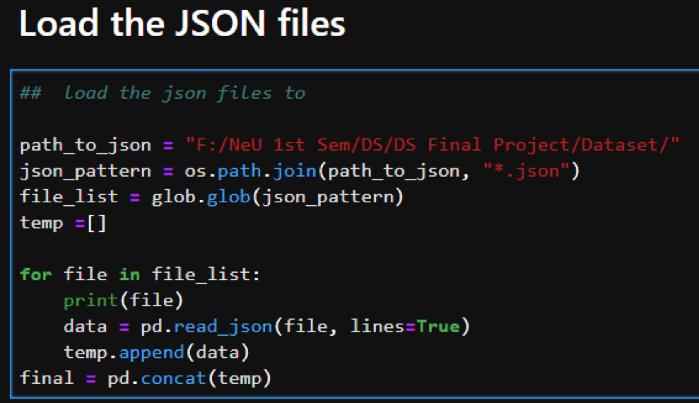
Importing Data
The raw files which we used for this project was in JSON format. We downloaded 3 JSON files from the source and stored them in a local path. Then, we used the “read_json” feature of pandas to import these file in DataFrame.

Slide 9
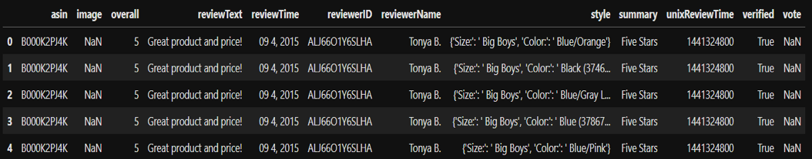
DATA PRE-PROCESSING
After viewing the general information, we observed below points:
The columns "reviewText" & "summary" appears to be the sentiments that we will be using for this analysis project
There aren't any other column to determine if the review is positive or negative. We will have to use the column "overall" as a road map.

Slide 10
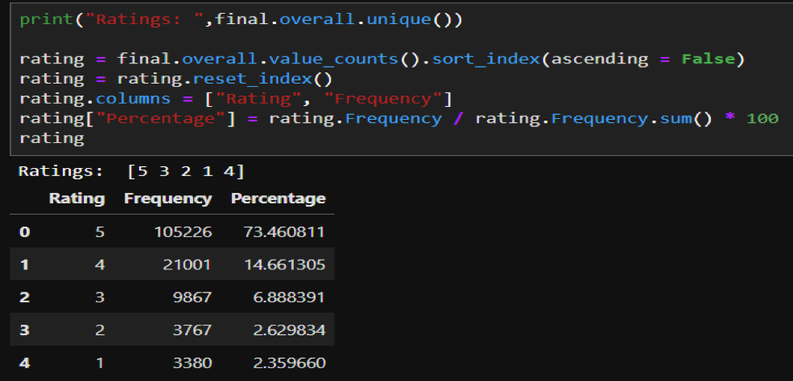
Let's determine the ratings by breaking it down to the type of ratings the data contains and distribution of the type of those ratings. We will determine what will be considered to be positive or negative and whether we will have an imbalanced dataset.

Slide 11
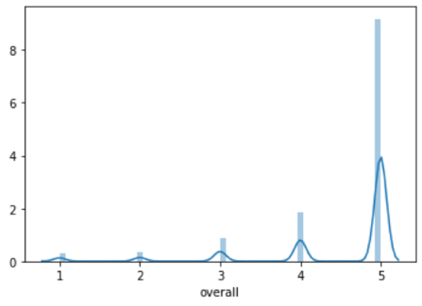
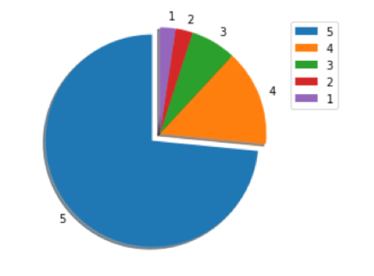
Pie-chart plot
Frequency distribution plot

Slide 12
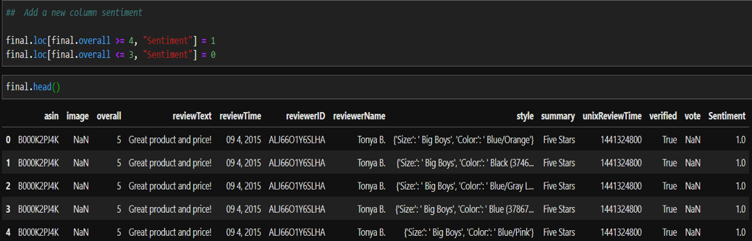
For this project, we will be using binary classification for sentimental analysis.
So, we created a new column “Sentiments” based on the ratings of the product.
We used the below approach:
If rating >=4, sentiment = 1 (positive review)
If rating <=3, sentiment = 0 (negative review)

Slide 13
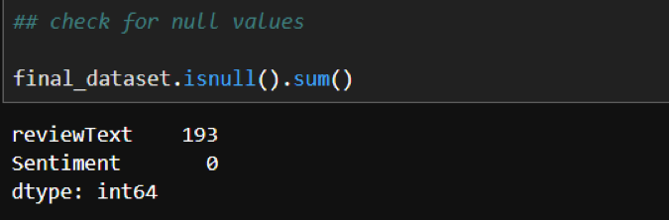
Steps to remove NaN values
Dataset consists of many duplicate and NaN entries which will affect the prediction model that will produce wrong outcomes. Following are the steps to remove these values.
Identifying the NaN values in the dataset using numpy.isull() function.

Slide 14
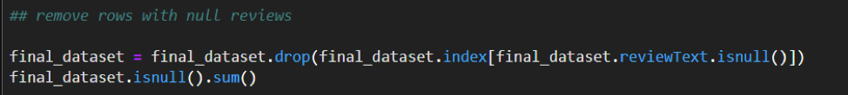
Droping these values from the Dataframe using numpy.drop() function.

Slide 15
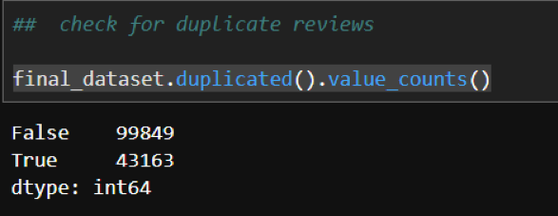
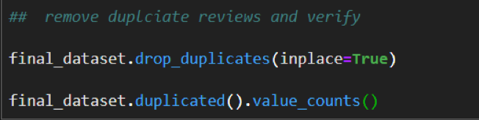
Steps to remove duplicate values
Identifying the duplicate values in the dataset using numpy.duplicated() function.
Removing the duplicate values from dataset using drop_duplicates() function.

Slide 16
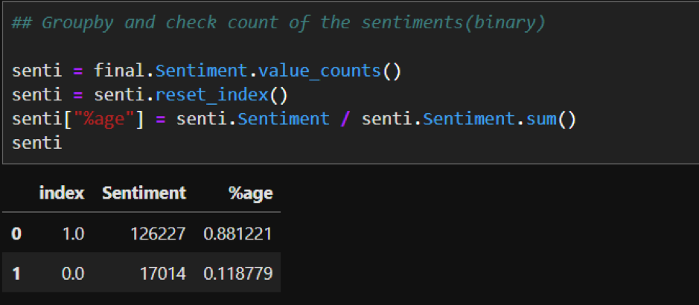
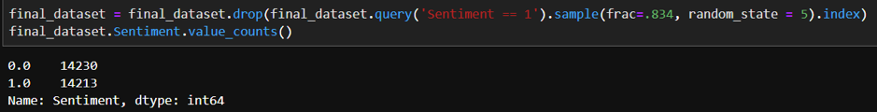
Steps to balance the data
After removing these values, we are ended up getting unbalanced data i.e. we have 80% of records which have positive feedback and only 20% of records have negative feedback. This highly unbalanced data that might prone to providing false predictions. Hence, we are balancing the data in the next stage.

Slide 17
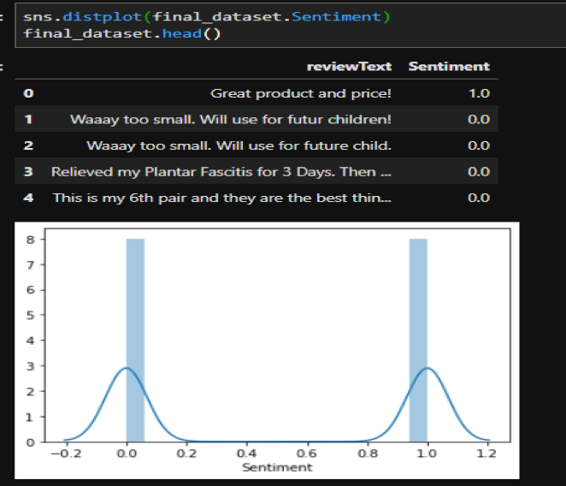
After this step, our dataset contains relevant information that might play an important role in the prediction of sentiment.

Slide 18
TF-IDF Vectorizer
Text data requires special preparation before you can start using it for predictive modelling. The text must be parsed to remove words, called tokenization. Then the words need to be encoded as integers or floating-point values for use as input to a machine learning algorithm, called feature extraction (or vectorization). We can use Count Vectorizer for feature extraction but the issue is that some words like “the” will appear many times and their large counts will not be very meaningful in the encoded vectors. An alternative is to calculate word frequencies, and by far the most popular method is called TF-IDF.
Term Frequency: This summarizes how often a given word appears within a document.
Inverse Document Frequency: This downscales words that appear a lot across documents.
The TF-IDF Vectorizer will tokenize documents, learn the vocabulary and inverse document frequency weightings, and allow you to encode new documents.

Slide 19
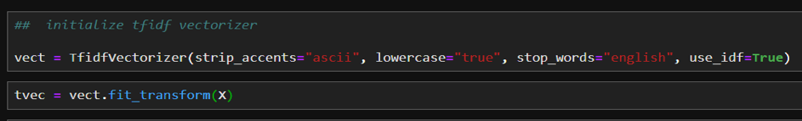
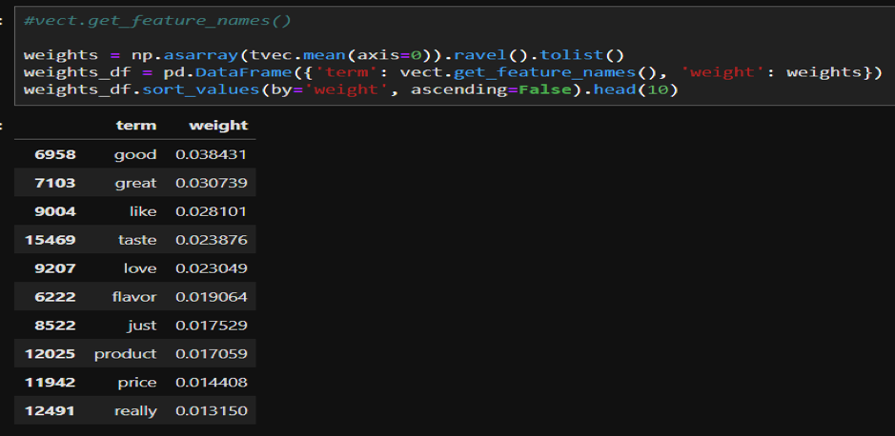
After this stage, we need to split the data into training and test set using below code sklearn.model_selection. train_test_split. Now, we are going to train supervised learning models using the above dataset.

Slide 20
Machine Learning Algorithms
Multinomial Naïve Bayes​
Random Forest​
Logistic Regression​
Decision Tree
Support Vector Machines (SVM)​
k-Nearest Neighbors (KNN)​

Slide 21
Multinomial Naïve Bayes
Multinomial Naive Bayes is a statistical classification technique based on Bayes Theorem. It is one of the simplest supervised learning algorithms. Naive Bayes classifier is the fast, accurate and reliable algorithm having high accuracy and speed on large datasets.
Naive Bayes is the most straightforward and most potent algorithm. In spite of the significant advances of Machine Learning in the last couple of years, it has proved its worth. It has been successfully deployed in many applications from text analytics to recommendation engines.
Naive Bayes classifier assumes that the effect of a particular feature in a class is independent of other features. We have used Multinomial Naïve Bayes model to train and predict our dataset.

Slide 22
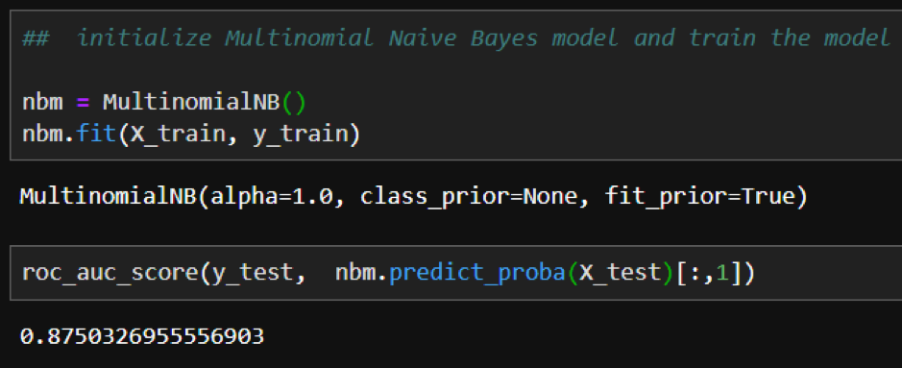
We are using roc_auc_score for measuring the accuracy of our model. The roc_auc_score always runs from 0 to 1, and is sorting predictive possibilities. 0.5 is the baseline for random guessing, so you want to always get above 0.5.
We were able to attain 87.5% roc_auc_score for our dataset.

Slide 23
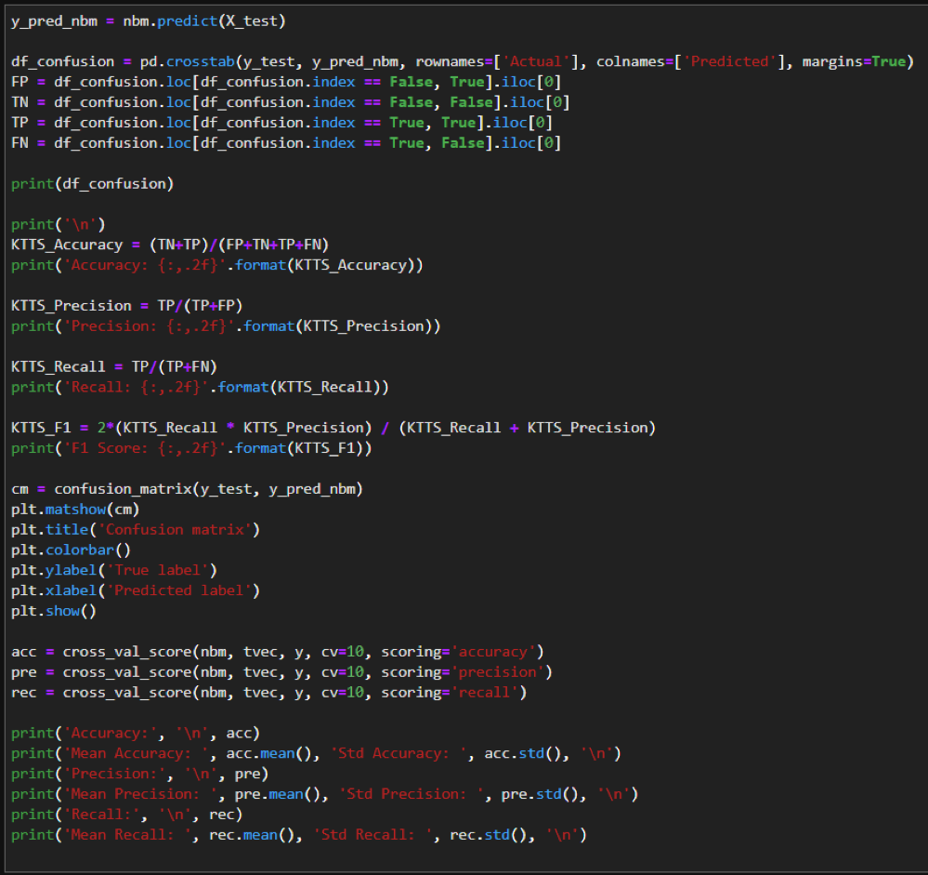
Confusion Matrix of Multinomial Naïve Bayes

Slide 24
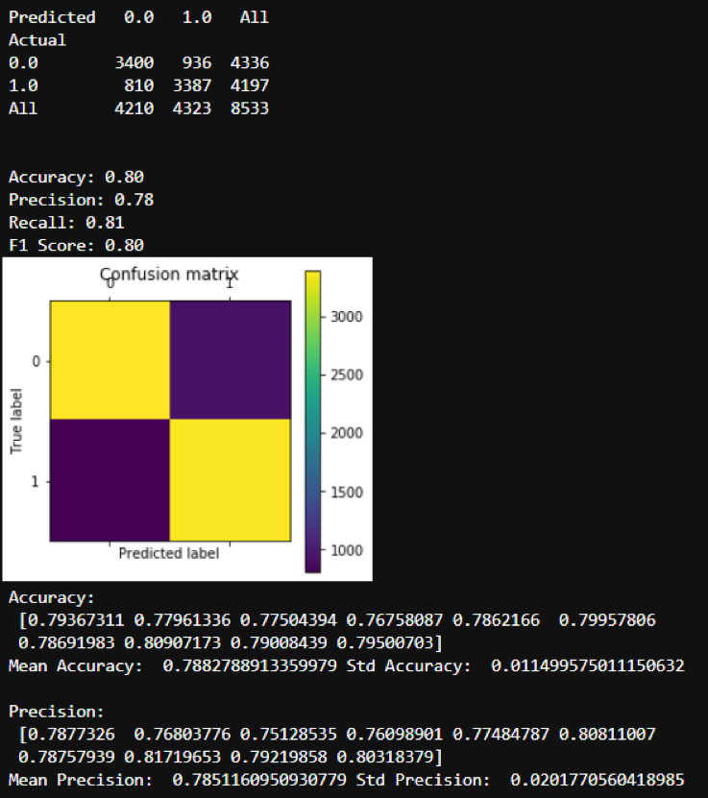

Slide 25
Decision Tree
A decision tree is a flowchart-like tree structure where an internal node represents feature (or attribute), the branch represents a decision rule, and each leaf node represents the outcome.
The topmost node in a decision tree is known as the root node. It learns to partition based on the attribute value. It partitions the tree in recursively manner call recursive partitioning.
This flowchart-like structure helps you in decision making. It's visualization like a flowchart diagram which easily mimics the human level thinking. That is why decision trees are easy to understand and interpret.

Slide 26
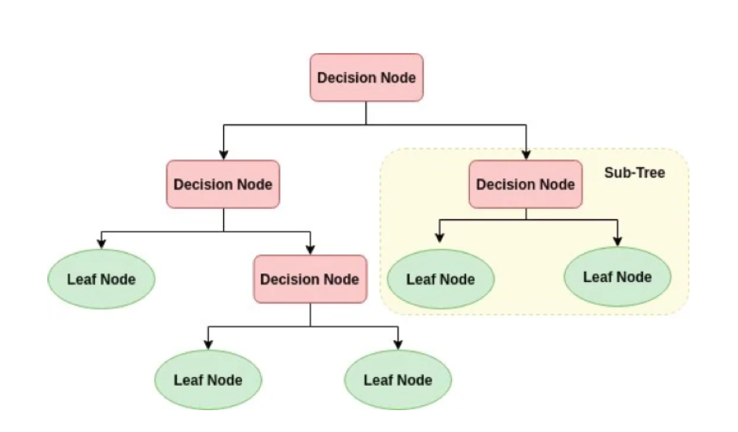

Slide 27
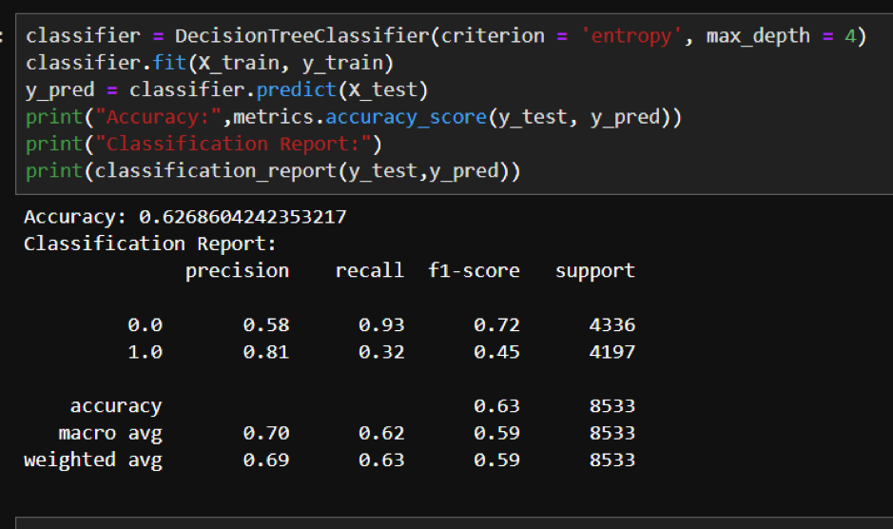
Accuracy of the Decision Tree model is around 62%

Slide 28
Logistic Regression
Logistic Regression is one of the simplest and commonly used Machine Learning algorithms for two-class classification. It is easy to implement and can be used as the baseline for any binary classification problem. Its fundamental concepts are also constructive in deep learning. Logistic regression describes and estimates the relationship between one dependent binary variable and independent variables.
Logistic regression is a statistical method for predicting binary classes. The outcome or target variable is dichotomous in nature. Dichotomous means there are only two possible classes. For example, it can be used for cancer detection problems. It computes the probability of an event occurrence.
Logistic Regression predicts the probability of occurrence of a binary event utilizing a logit function.

Slide 29
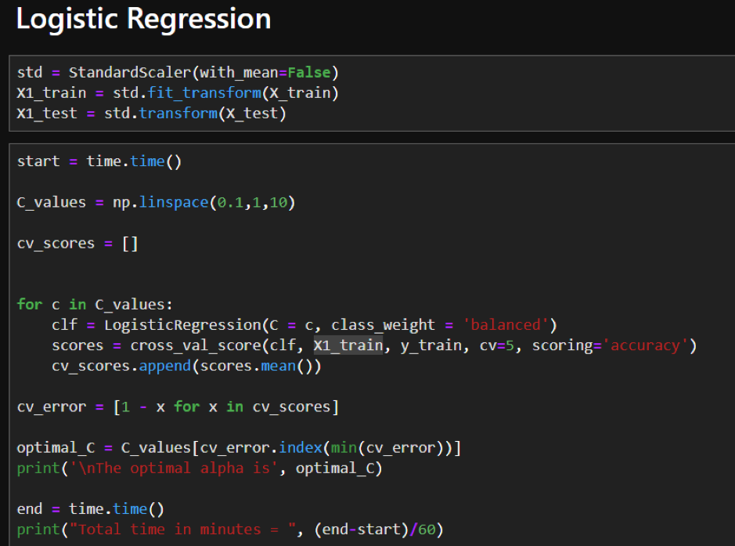
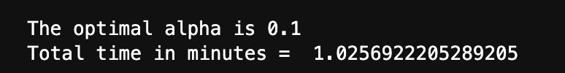

Slide 30
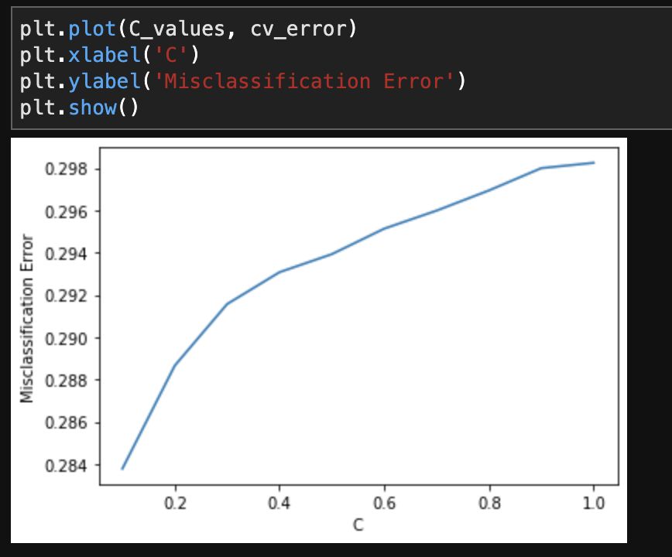
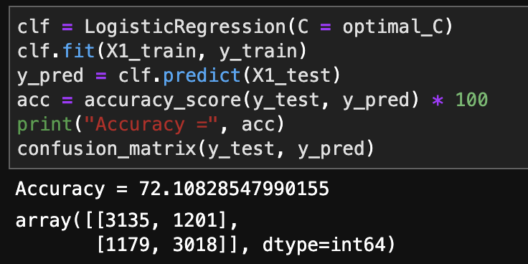
This model has 72% accuracy.

Slide 31
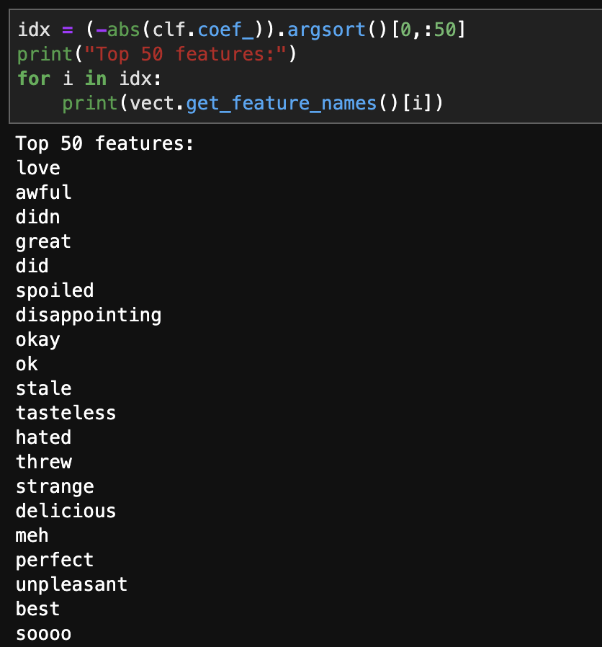
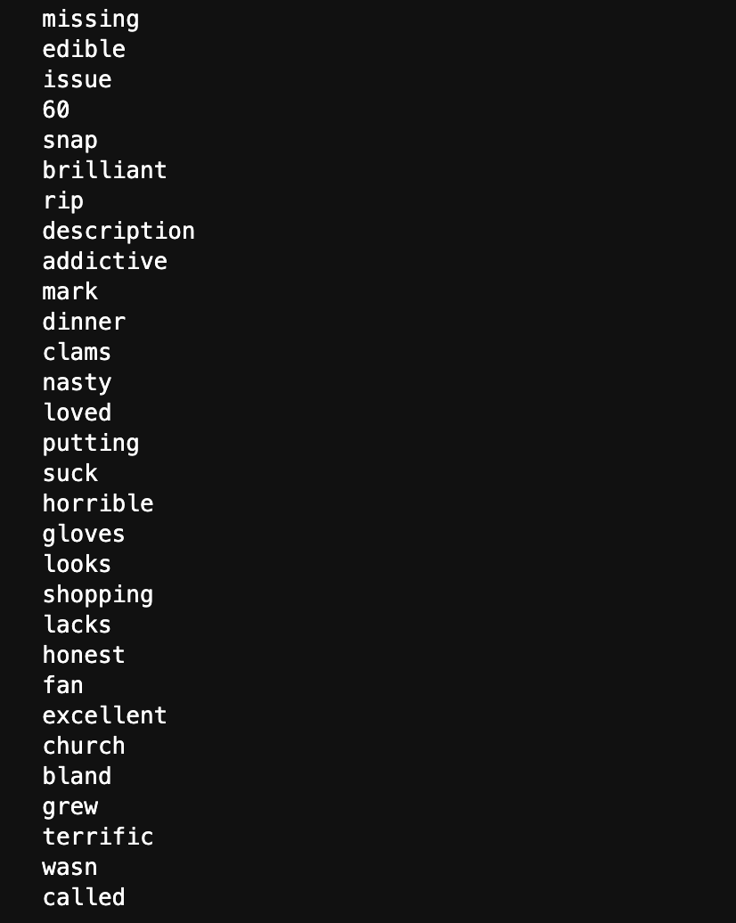

Slide 32
Random Forest
Random forests is a supervised learning algorithm. It can be used both for classification and regression. It is also the most flexible and easy to use algorithm. A forest is comprised of trees.
It is said that the more trees it has, the more robust a forest is. Random forests creates decision trees on randomly selected data samples, gets prediction from each tree and selects the best solution by means of voting. It also provides a pretty good indicator of the feature importance.
Random forests have a variety of applications, such as recommendation engines, image classification and feature selection. It can be used to classify loyal loan applicants, identify fraudulent activity and predict diseases. It lies at the base of the Boruta algorithm, which selects important features in a dataset.

Slide 33
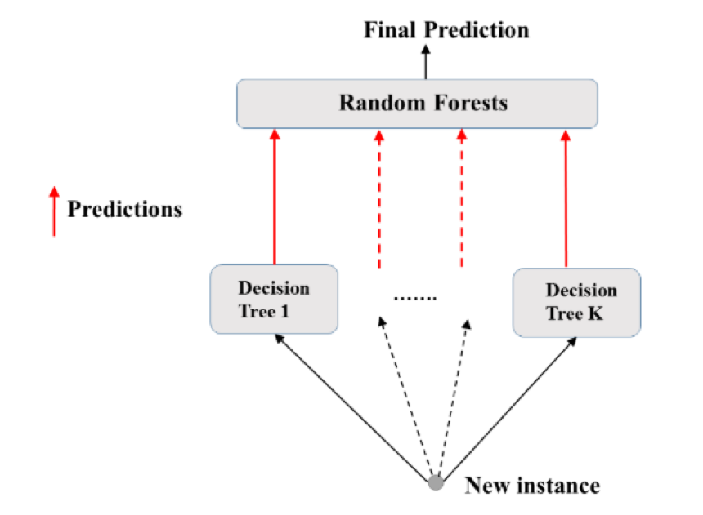

Slide 34
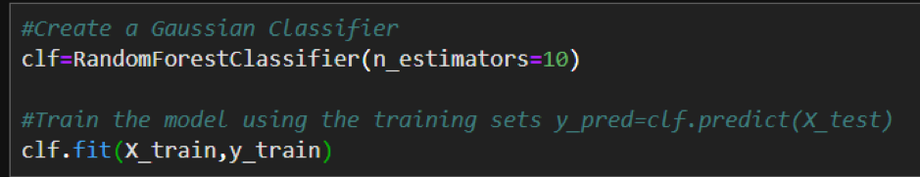
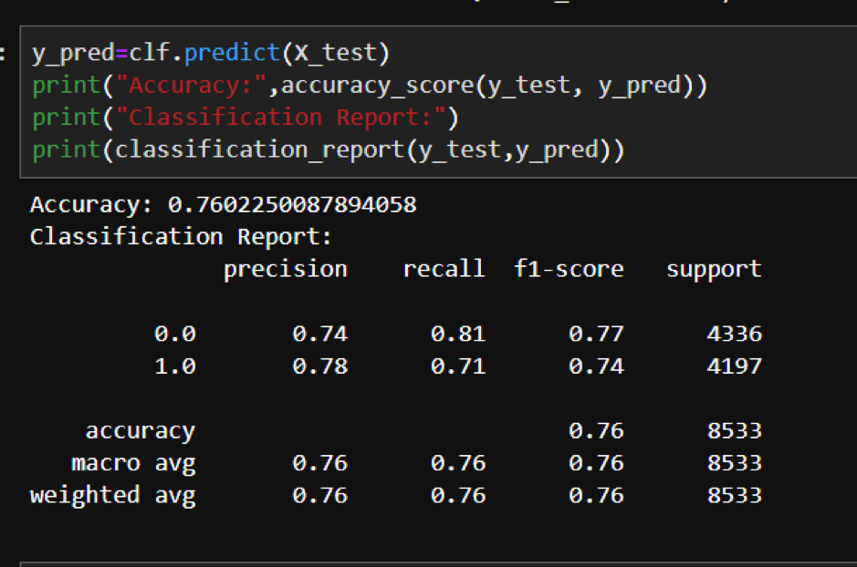

Slide 35
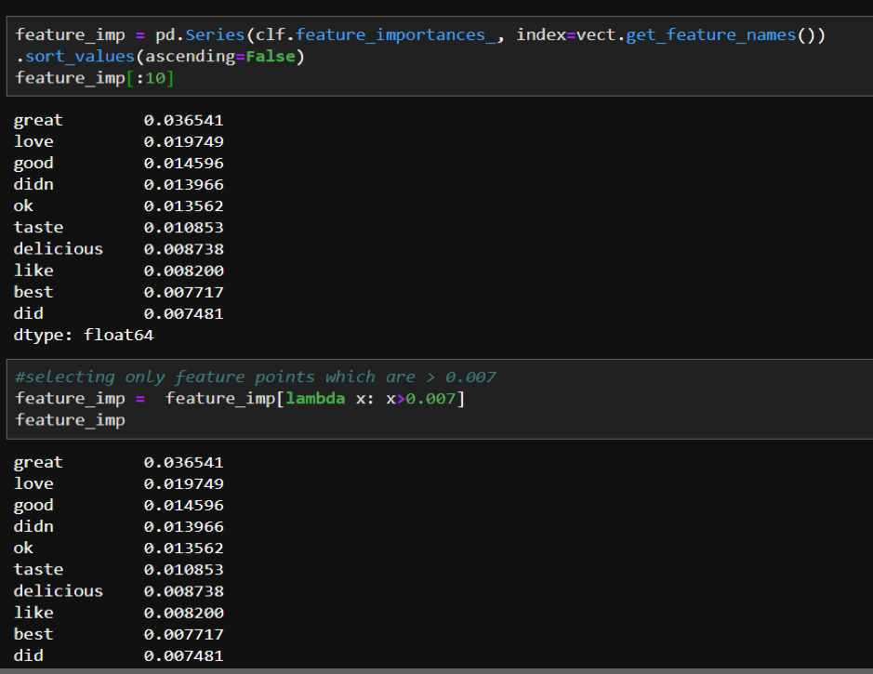
We can increase the accuracy of decision tree using following ways:
Feature Importance: We need to select only important features those drives the prediction of the review text. By selecting important features, we are removing the redundant data from the calculation. The below output where we are selecting the features with greater than 0.007 importance.

Slide 36
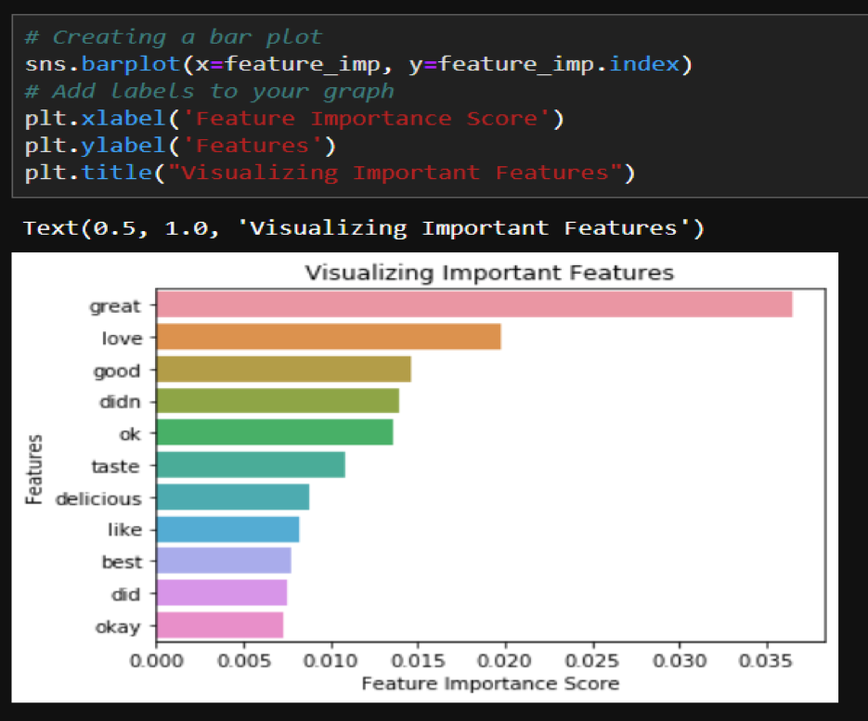
The visual representation of feature importance

Slide 37
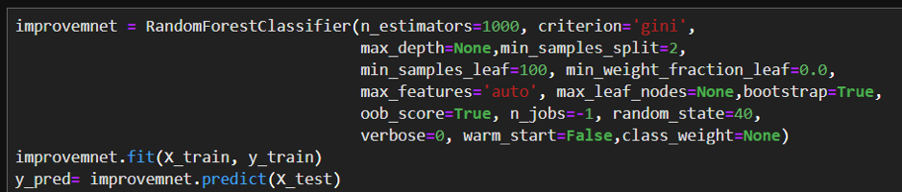
Algorithm tuning
The objective of parameter tuning is to find the optimum value for each parameter to improve the accuracy of the model.

Slide 38
SUPPORT VECTOR MACHINES ( SVM )
SVM offers very high accuracy compared to other classifiers such as logistic regression, and decision trees. It is known for its kernel trick to handle nonlinear input spaces. It is used in a variety of applications such as face detection, intrusion detection, classification of emails, news articles and web pages, classification of genes, and handwriting recognition.
SVM is an exciting algorithm and the concepts are relatively simple. The classifier separates data points using a hyperplane with the largest amount of margin.
That's why an SVM classifier is also known as a discriminative classifier. SVM finds an optimal hyperplane which helps in classifying new data points.

Slide 39
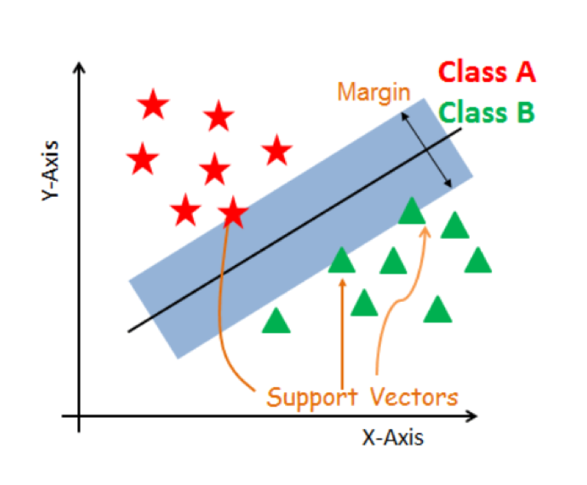

Slide 40
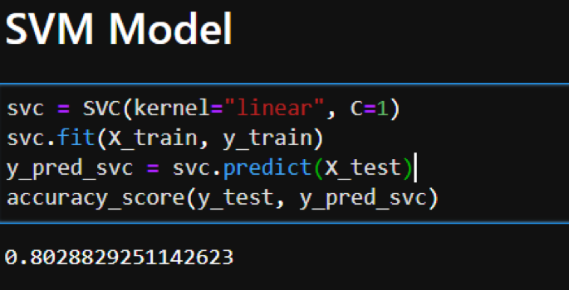
We trained our SVM model with different values of C and kernel.
We found that maximum accuracy can be attained when kernel=”linear” & C=1.
We tried all different values of kernel C and gamma and found the most optimal values

Slide 41
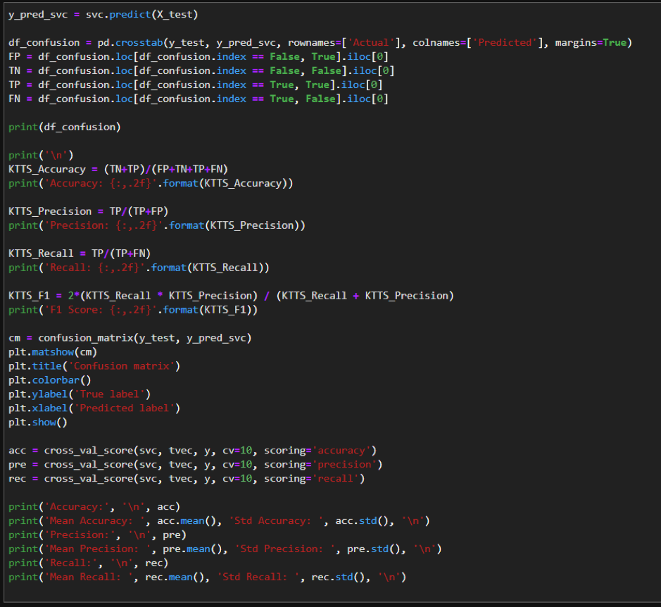
Confusion Matrix of SVM Model​

Slide 42
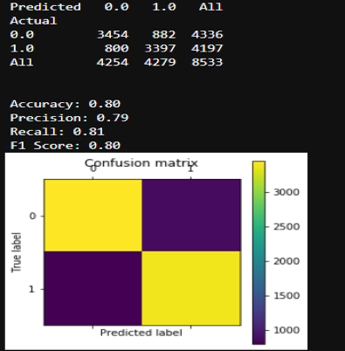

Slide 43
K-Nearest Neighbours
K-Nearest Neighbours, or KNN for short, is one of the simplest machine learning algorithms and is used in a wide array of institutions.
KNN is a non-parametric, lazy learning algorithm. When we say a technique is non-parametric, it means that it does not make any assumptions about the underlying data. In other words, it makes its selection based off of the proximity to other data points regardless of what feature the numerical values represent.
Being a lazy learning algorithm implies that there is little to no training phase. Therefore, we can immediately classify new data points as they present themselves.

Slide 44
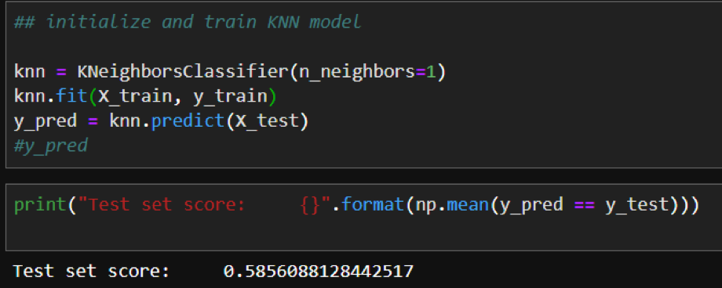
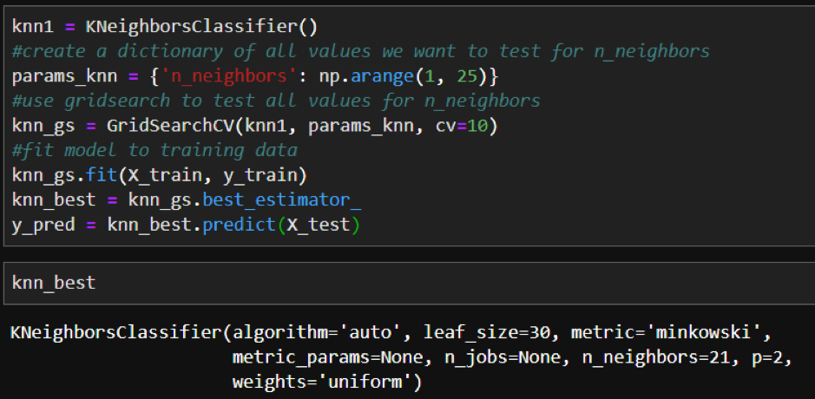
We trained our model initially with n=1 and got an accuracy of 62%.
Then we performed parameter optimization, but this didn’t help much in increasing the accuracy of the model.

Slide 45
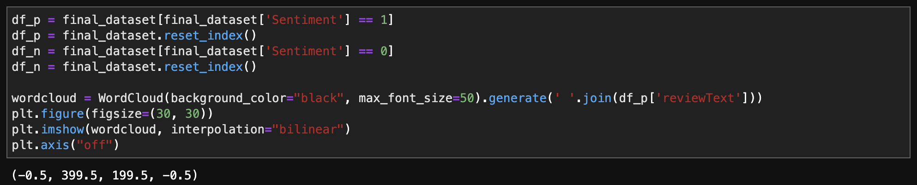
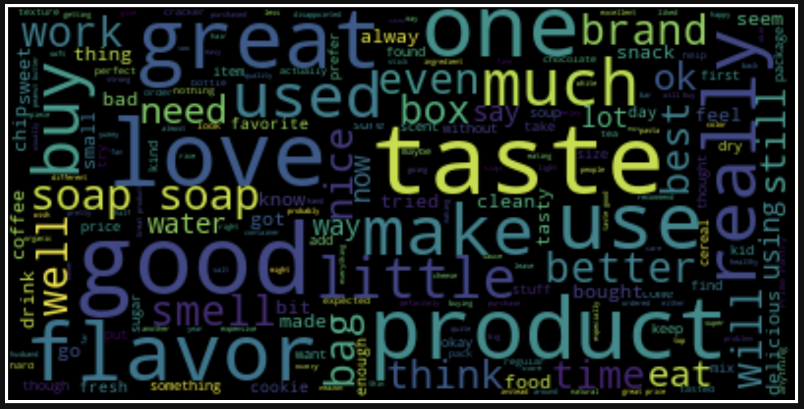
We have created a word map based on the sentiments and reviews of the amazon products respectively.

Slide 46
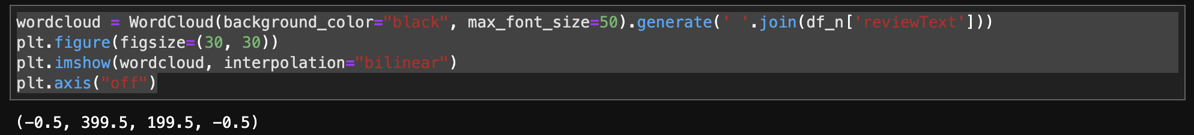
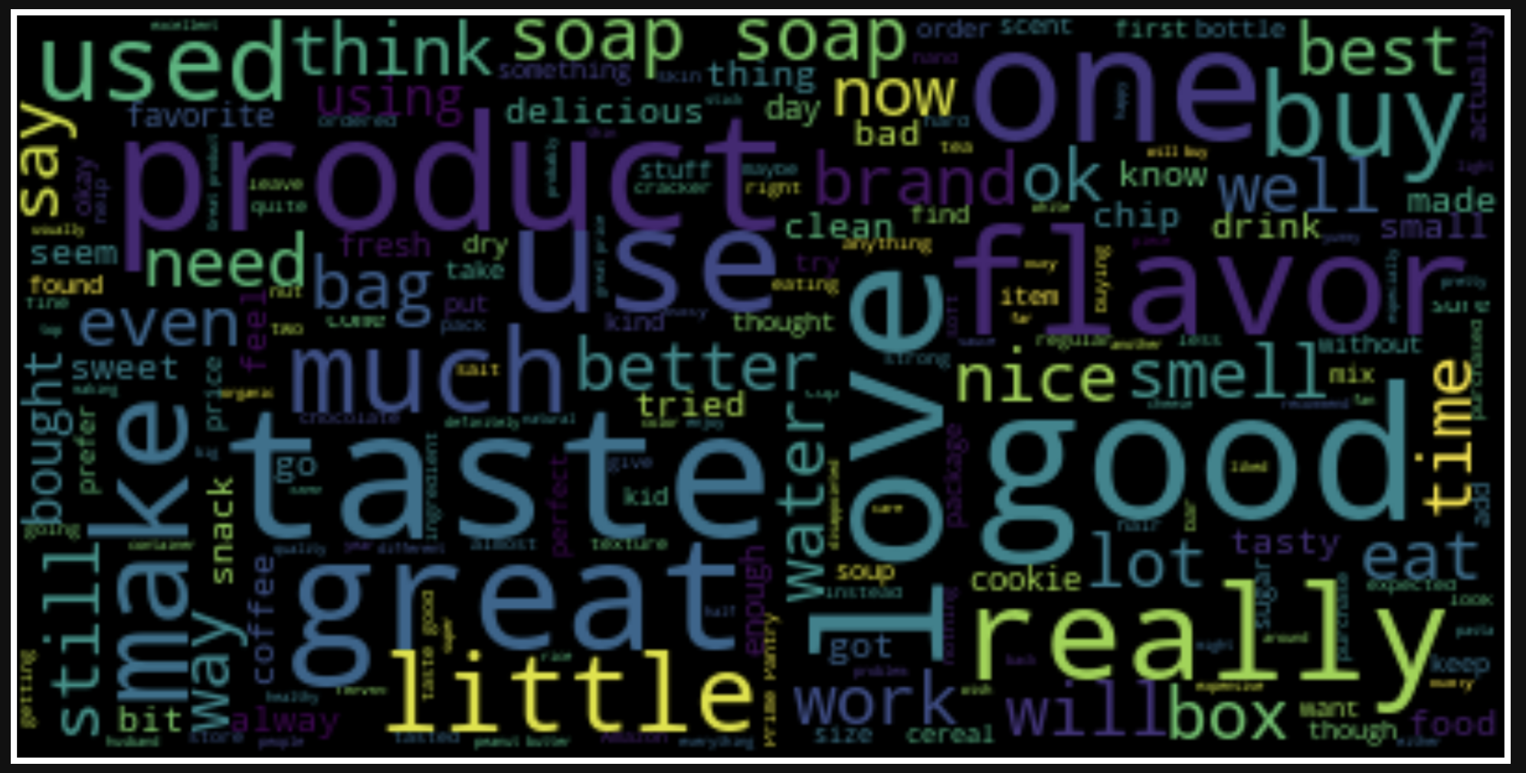

Slide 47
Conclusion
We performed data pre-processing and used NLTK WordNet Lemmatizer to lemmatize the sentences. We used TF-IDF Vectorizer to change the text of our review to numerical data. Post this, we implemented different Supervised Machine learning algorithms to check how well these models can learn from the training dataset and able to make correctpredictions on the test dataset.
Out of all the 6 models which we used in this project; Multinomial Naïve Bayes turns out to be best among them with 87.4% predict probability score.
We cross-validated this by running the model for our own reviews and got the desired output.

Slide 48
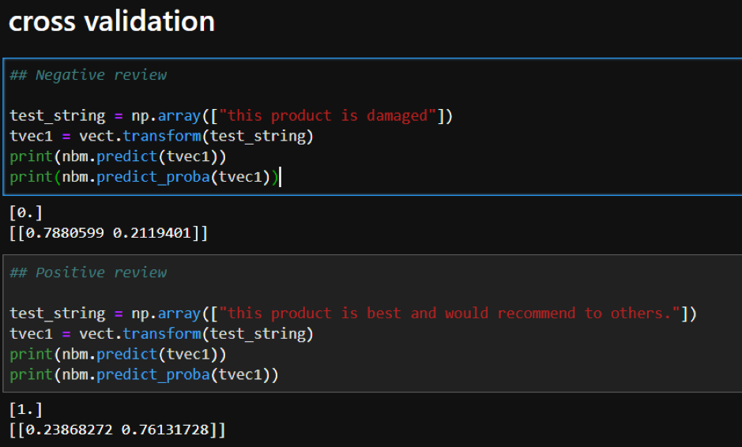

Slide 49
Refereneces
https://www.analyticsvidhya.com/blog/2015/12/improve-machine-learning-results/
https://towardsdatascience.com/improving-random-forest-in-python-part-1-893916666cd
https://towardsdatascience.com/machine-learning-basics-with-the-k-nearest-neighbors-algorithm-6a6e71d01761
https://medium.com/capital-one-tech/k-nearest-neighbors-knn-algorithm-for-machine-learning-e883219c8f26
https://medium.com/@penggongting/implementing-decision-tree-from-scratch-in-python-c732e7c69aea
https://www.datacamp.com/community/tutorials/text-analytics-beginners-nltk

Slide 50

Thank You !

